Slide 1
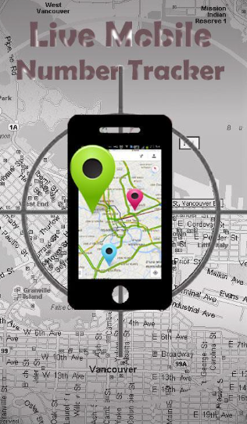
TRACKING PHONE NUMBER LOCATION AND SIM CARD DETAILS
Submitted by :
M.V.N.DHEERAJ

Slide 2
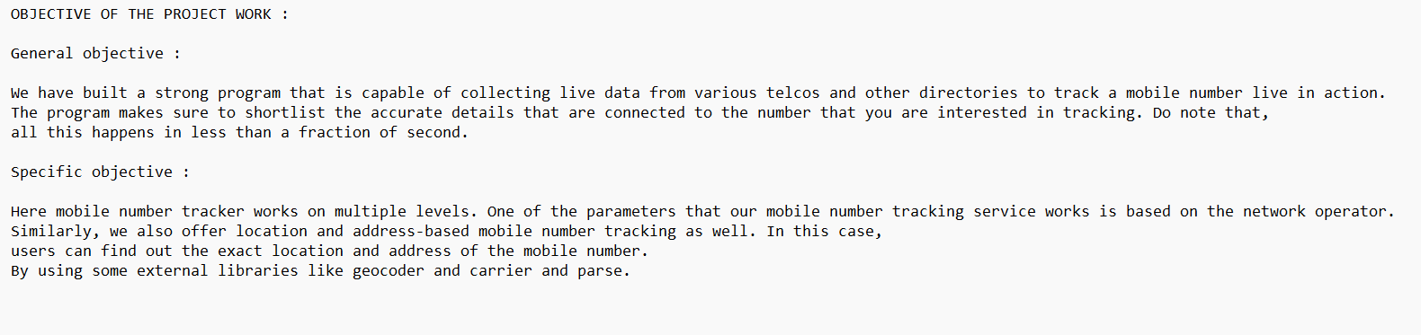
OBJECTIVE OF THE PROJECT:

Slide 3
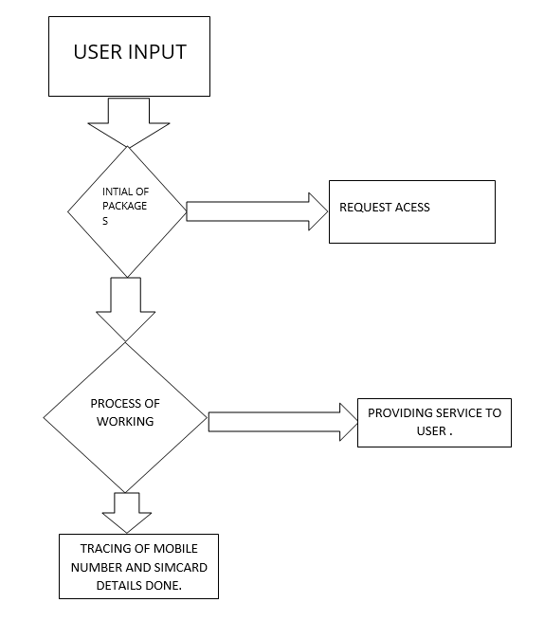
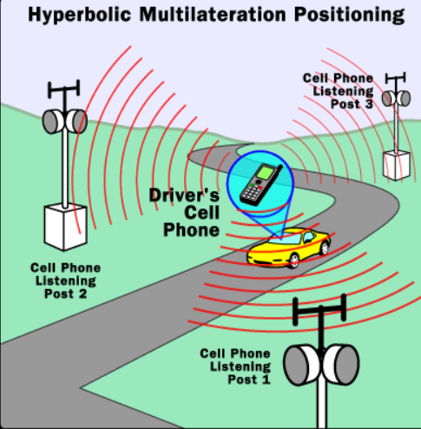
FLOW CHART :

Slide 4
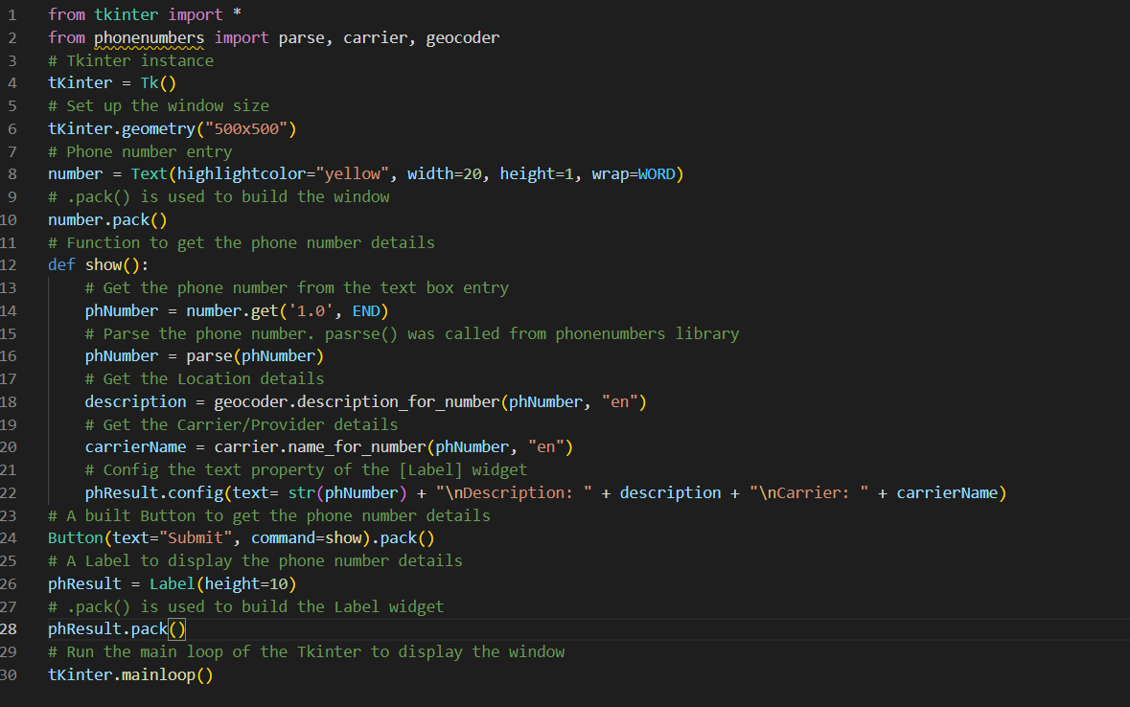
IMPLENTATION AND CODING :

Slide 5

OUTPUT :

Slide 6
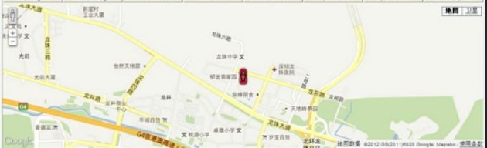
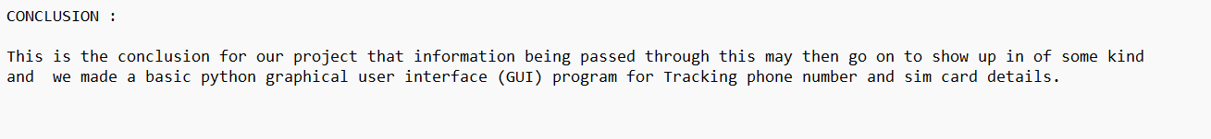

Slide 7
thankyou

